Slide 1
Entrepreneurship Development
BUS 304
Module- 1
Fundamental of Entrepreneurship

Slide 2
Learning Outline
Definition of Entrepreneurship
The Nature and characteristic of etrepreneurship
Entrepreneurship concept
Entrepreneurship roles influence
Economical influence

Slide 3
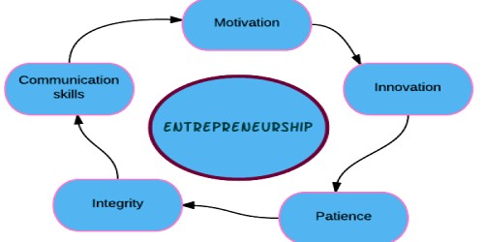
Entrepreneurship

Slide 4
What is Entrepreneurship?
Entrepreneurship is the act of creating a business or businesses while building and scaling it to generate a profit.
This entrepreneur definition can be a bit vague but for good reason. An entrepreneur can be a person who sets up their first online store on the side or a freelancer just starting out.
The meaning entrepreneur involves much more than being a business or job creator. Entrepreneurs are some of the world’s most powerful transformers. From Elon Musk sending people to Mars to Bill Gates and Steve Jobs making computers part of every household, entrepreneurs imagine the world differently.

Slide 5
What Is an Entrepreneur?
An entrepreneur is an individual who creates a new business, bearing most of the risks and enjoying most of the rewards. The entrepreneur is commonly seen as an innovator, a source of new ideas, goods, services, and business/or procedures.
Entrepreneurs play a key role in any economy, using the skills and initiative necessary to anticipate needs and bring good new ideas to market. Entrepreneurs who prove to be successful in taking on the risks of a startup are rewarded with profits, fame, and continued growth opportunities. Those who fail, suffer losses and become less prevalent in the markets.

Slide 6
Entrepreneur…
A person who undertakes the risk of starting a new business venture is called and entrepreneur.
An entrepreneur creates a firm, which aggregates capital and labor in order to produce goods or services for profit.
Entrepreneurship is an important driver of economic growth and innovation.
Entrepreneurship is high-risk, but also can be high-reward as it serves to generate economic wealth, growth and innovation.

Slide 7
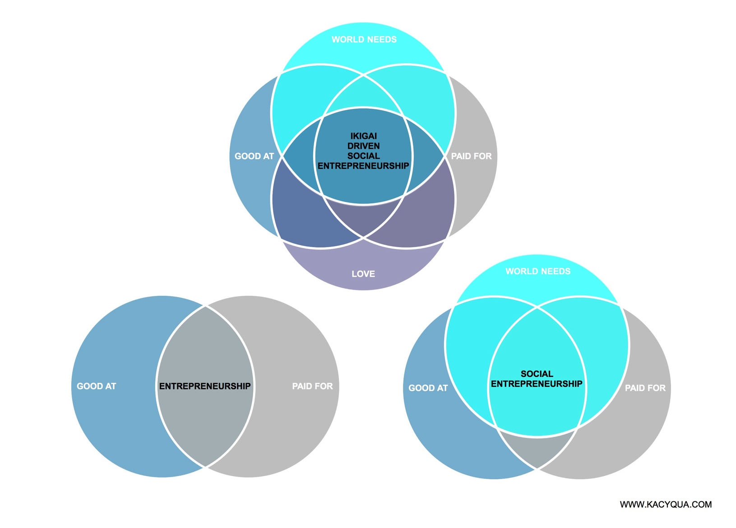

Slide 8
Entrepreneurial Ideas
A startup entrepreneur can build almost any type of business. Here are a few business ideas to get you started:
Ecommerce store owner
Freelancer (write a blog, accountant, designer)
Teaching (online courses, author)
App creator (Chabot's, social media apps)
Service based business (food delivery, cleaning, dog walking)
Consultant based business (wedding planner, life coach)
Apartment rentals (Air bnb)
Marketing businesses (PR firms, influencers, SEO brands)

Slide 9
Entrepreneurial Ideas…
Affiliate marketing (Amazon, Clickbank, etc)
Blogger (Product reviews, niche blog, magazine)
Vlogger (Start a YouTube channel, Twitch)
Flipper (domain name, website, house)
Translator
Gig Economy (driver)
Real estate agent (condos, houses, commercial)
Photographer (product photography, sell photos)
Stock Broker (buying and selling stocks)
Tutor
Reseller business

Slide 10
The Characteristics Entrepreneurship
Ensure Financial Stability
Though financial estability is not a vital requirement but is definitely recommended. While entrepreneurs have built successful businesses while being less than financially flush (think of Facebook founder Mark Zuckerberg as a college student), starting out with an adequate cash supply and ensuring ongoing funding can only help an aspiring entrepreneur, increasing his or her personal runway and give him more time to work on building a successful business, rather than worrying about making quick money.

Slide 11
The Characteristics Entrepreneurship
Build a Diverse Skill Set
Once a person has strong finances, it is important to build a diverse set of skills and then apply those skills in the real world. The beauty of step two is it can be done concurrently with step one.
Building a skill set can be achieved through learning and trying new tasks in real-world settings. For example, if an aspiring entrepreneur has a background in finance, he can move into a sales role at his existing company to learn the soft skills necessary to be successful. Once a diverse skill set is built, it gives an entrepreneur a toolkit that he can rely on when he is faced with the inevitability of tough situations.

Slide 12
The Characteristics Entrepreneurship
Consume Content Across Multiple Channels
As important as building a diverse skill set is, the need to consume a diverse array of content is equally so. This content can be in the form of podcasts, books, articles or lectures. The important thing is that the content, no matter the channel, should be varied in what it covers. An aspiring entrepreneur should always familiarize himself with the world around him so he can look at industries with a fresh perspective, giving him the ability to build a business around a specific sector.

Slide 13
The Characteristics Entrepreneurship
Identify a Problem to Solve
“Where there is a problem , there is opportunity” across multiple channels, an aspiring entrepreneur is able to identify various problems to solve. One business adage dictates that a company's product or service needs to solve a specific pain point either for another business or for a consumer group. Through the identification of a problem, an aspiring entrepreneur is able to build a business around solving that problem.

Slide 14
The Characteristics Entrepreneurship
Entrepreneurs create jobs
Without entrepreneurs, jobs wouldn’t exist. Entrepreneurs take on the risk to employ themselves. Their ambition to continue their business’ growth eventually leads to the creation of new jobs. As their business continues to grow, even more jobs are created. Thus, lowering unemployment rates while helping people feed their families.

Slide 15
The Characteristics Entrepreneurship
Entrepreneurs innovate
Some of the greatest technologies in today’s society have come from businesses. The technological advances come out of a need to solve a problem, create efficiencies, or improve the world. Thus, in periods where there’s more advancement in technology, it’s usually due to the work of an entrepreneur.
Entrepreneurs create change
Entrepreneurs dream big so naturally some of their ideas will make worldwide change. They might create a new product that solves a burning problem or take on the challenge to explore something never explored before. Many believe in improving the world with their products, ideas or businesses.

Slide 16
The Characteristics Entrepreneurship
Entrepreneurs give to society
While some have this notion of the rich being evil and greedy, they often do more for the greater good than the average person. They make more money and thus pay more in taxes which helps fund social services. Entrepreneurs are some of the biggest donors to charities and nonprofits for various causes. Some seek to invest their money in creating solutions to help poorer communities have access to things we take for granted like clean drinking water and good health care.

Slide 17
The Characteristics Entrepreneurship
Entrepreneurship decreases poverty
In the spirit of sharing good news, more people are being pulled out of poverty today than ever before. This is likely due to globalization. Being able to connect to millions and billions of people on the internet allows new entrepreneurs to find customers around the world. So, those who want to make money online are able to do so to get out of poverty.
To change the world
Many entrepreneurs strive to make the world better. Whether entrepreneurs believe in space exploration, eliminating poverty or creating a practical but game-changing product, they ultimately build a brand in service of others. Some entrepreneurs use their business as a way to raise capital quickly to funnel into their noble causes. To social entrepreneurs, building an empire is about creating a better world for everyone.

Slide 18
The Characteristics Entrepreneurship
They’re curious
Entrepreneurs love finding out the answer to the question, ‘what will happen, if ’ they’re experimental. Entrepreneurs love learning. They regularly read business books to advance their knowledge. So naturally, entrepreneurship appeals to them because doing allows them to learn the most in the shortest amount of time. Their curiosity allows their continued growth.
They’re ambitious
Those who love reaching difficult goals and milestones are made to be entrepreneurs. There’s no limit to how much an entrepreneur can make and so they can always work to achieve higher levels of greatness. Since there’s no limit to what they can achieve, entrepreneurs constantly find themselves growing and achieving more than they ever imagined. When obstacles get presented in front of them, they find the workaround to their goal. Entrepreneurs are unstoppable.

Slide 19
What is Entrepreneur Skill ?
There are many skills required to start a business. The most popular entrepreneur skills are marketing, business development, customer service, leadership, execution, resilience, focus, determination, talent acquisition, continuous learner. Want to find more popular entrepreneur skills? Check out these business skills.

Slide 20
Concept of Entrepreneur
Innovation
An entrepreneur is the key source of innovation and variation in an economy. It is actually one of the most important tools of an entrepreneurs success. They use innovation to exploit opportunities available in the market and overcome any threats.
So this innovation can be a new product, service, technology, production technique, marketing strategy, etc. Or innovation can involve doing something better and more economically. Either way in the concept of entrepreneurship, it is a key factor.

Slide 21
Concept of Entrepreneur
Risk-Taking
Entrepreneurship and risk-taking go hand in hand. One of the most important features of entrepreneurship is that the whole business is run and managed by one person. So there is no one to share the risks with.
Not taking any risks can stagnate a business and excessive impulsive risk-taking can cause losses. So a good entrepreneur knows how to take and manage the risks of his business. But the willingness of an entrepreneur to take risks gives them a competitive edge in the economy. It helps them exploit the opportunities the economy provides.

Slide 22
Concept of Entrepreneur
Vision
Vision or foresight is one of the main driving forces behind any entrepreneur. It is the energy that drives the business forward by using the foresight of the entrepreneur. It is what gives the business an outline for the future – the tasks to complete, the risks to take, the culture to establish, etc.
All great entrepreneurs of the world that started with an entrepreneurship business are known to have great vision. This helps them set out short term and long term goals for their business and also plan ways to achieve these objectives.

Slide 23
Concept of Entrepreneur
Organization
In entrepreneurship, it is essentially a one-man show. The entrepreneur bears all the risks and enjoys all the rewards. And sure he has the help of employees and middle-level management, yet he must be the one in ultimate control. This requires a lot of organization and impeccable organizational skills.
An entrepreneur must be able to manage and organize his finances, his employees, his resources, etc. So his organizational abilities are one of the most important elements of entrepreneurship.

Slide 24
Concept of Entrepreneur
Creation of Businesses/Organization
Entrepreneurship is essentially a business owned entirely by one person. And the majority of these businesses are actually single handly run by the entrepreneurs themselves. So they assemble and coordinate their factors of production. They create their organizations from the ground up. They even learn some managerial skills along the way.

Slide 25
Concept of Entrepreneur
Economic Development
Entrepreneurs play a very important role in the national economy of any country. They are the spark that ignites the flames of economic development in a country.
They not only invest their own capital but also attract capital from the market. Entrepreneurs make productive use of these savings, they mobilize them and turn them into a productive resource.

