Slide 1
3D TRANSFORMATION

Slide 2
CONTENTS
Transformation
Types of transformation
Why we use transformation
3D Transformation
3D Translation
3D Rotation
3D Scaling
3D Reflection
3D Shearing

Slide 3
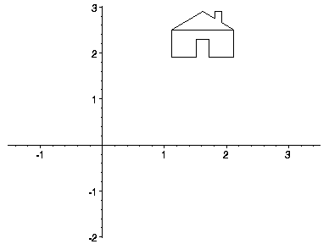
Transformation
Transformations are a fundamental part of the computer graphics. Transformations are the movement of the object in Cartesian plane .

Slide 4
Types of transformation
There are two types of transformation in computer graphics.
1) 2D transformation
2) 3D transformation
Types of 2D and 3D transformation
1) Translation
2) Rotation
3) Scaling
4) Shearing
5) Mirror reflection

Slide 5
Why we use transformation
Transformation are used to position objects , to shape object , to change viewing positions , and even how something is viewed.
In simple words transformation is used for
1) Modeling
2) viewing

Slide 6
3D transformation
When the transformation takes place on a 3D plane, it is called 3D transformation.
Generalize from 2D by including z coordinate
Straight forward for translation and scale, rotation more difficult
Homogeneous coordinates: 4 components
Transformation matrices: 4×4 elements

Slide 7
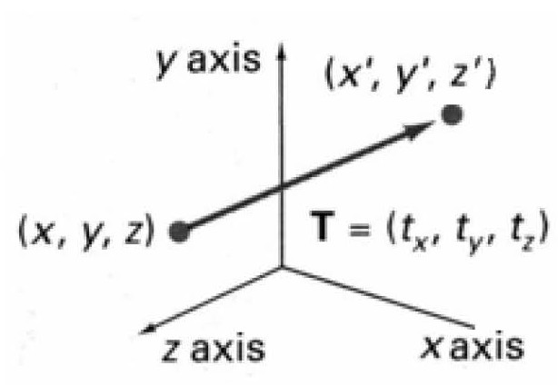
3d translation
Moving of object is called translation.
In 3 dimensional homogeneous coordinate representation , a point is transformed from position P = ( x, y , z) to P’=( x’, y’, z’)
This can be written as:-
Using P’ = T . P

Slide 8
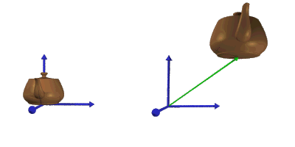
3D translation
The matrix representation is equivalent to the three equation.
x’=x+ t_{x} , y’=y+ t_{y} , z’=z+ t_{z}
Where parameter t_{x ,} t_{y ,} t_{z} are specifying translation distance for the coordinate direction x , y , z are assigned any real value.

Slide 9
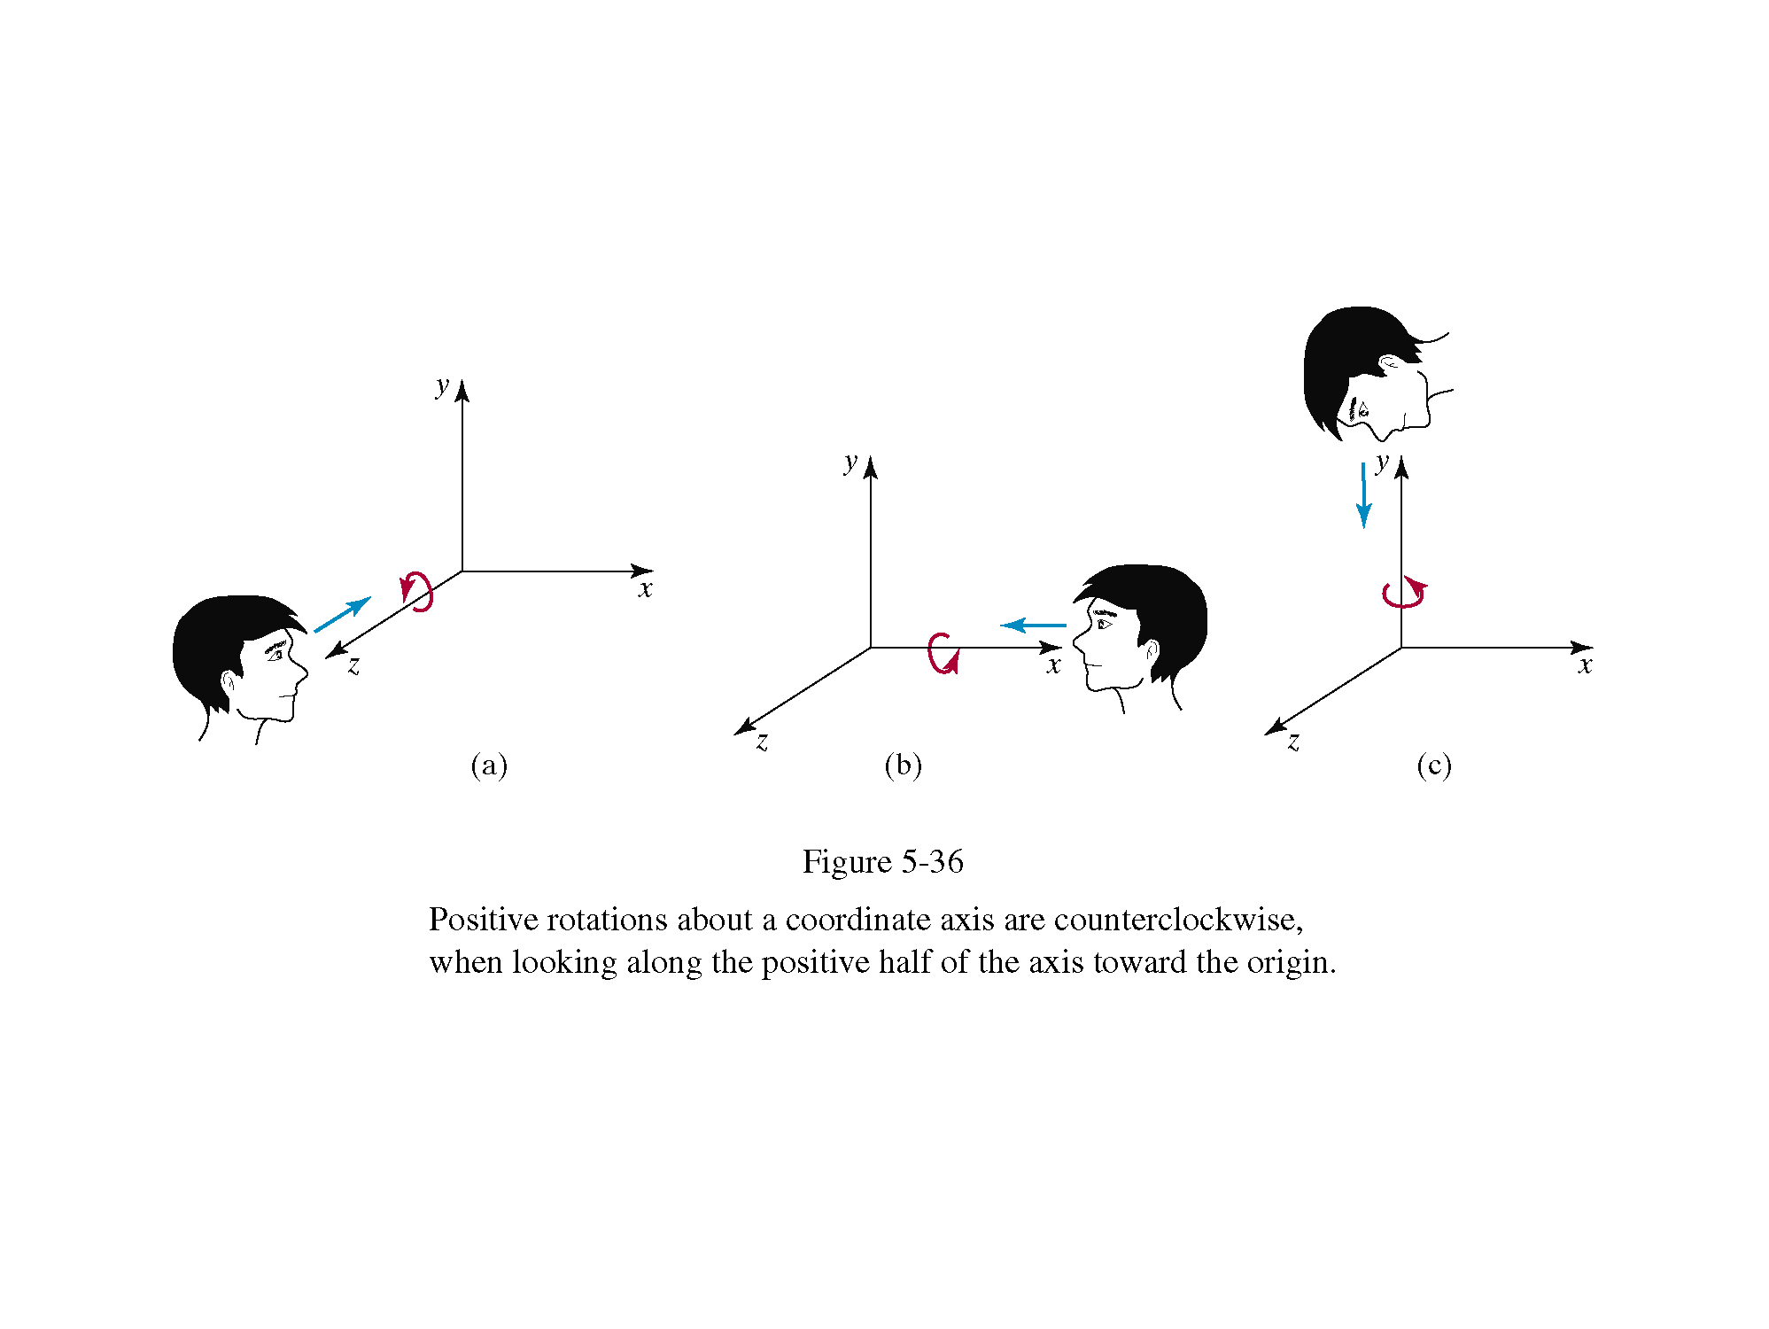
3D rotation
Where an object is to be rotated about an axis that is parallel to one of the coordinate axis, we can obtain the desired rotation with the following transformation sequence.
Coordinate axis rotation
Z- axis Rotation
Y-axis Rotation
X-axis Rotation

Slide 10
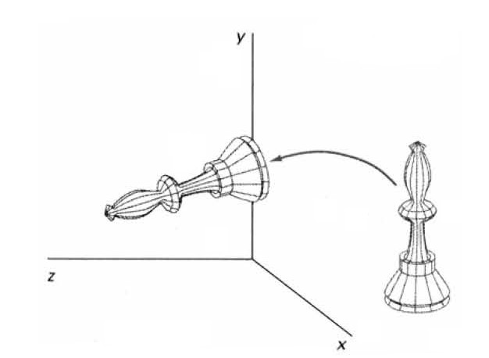
X-axis rotation
The equation for X-axis rotation
x’ = x
y’ = y cosθ – z sinθ
z’ = y sinθ + z cosθ

Slide 11
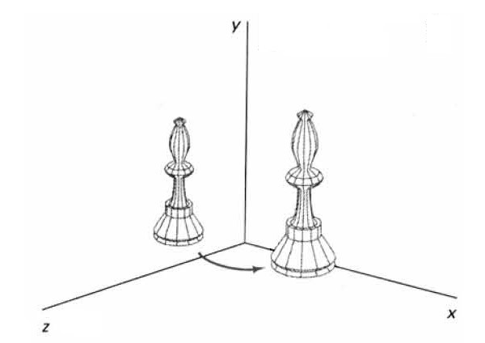
Y-axis rotation
The equation for Y-axis rotaion
x’ = x cosθ + z sinθ
y’ = y
z’ = z cosθ - x sinθ

Slide 12
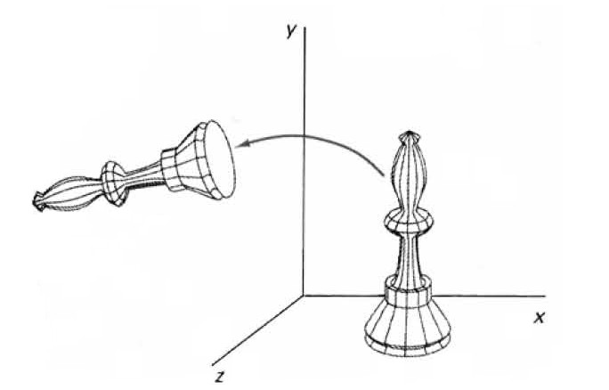
Z-axis rotation
The equation for Z-axis rotation
x’ = x cosθ – y sinθ
y’ = x sinθ + y cosθ
z’ = z

Slide 13
3d scaling
Changes the size of the object and repositions the object relative to the coordinate origin.

Slide 14
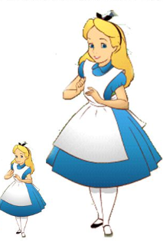
3d scaling
The equations for scaling
x’ = x . sx
S_{sx,sy,sz} ➔ y’ = y . sy
z’ = z . sz

Slide 15

3D reflection
Reflection in computer graphics is used to emulate reflective objects like mirrors and shiny surfaces
Reflection may be an x-axis
y-axis , z-axis. and also in
the planes xy-plane,yz-plane , and
zx-plane.
Reflection relative to a given
Axis are equivalent to 180
Degree rotations

Slide 16
3d reflection
Reflection about x-axis:-
x’=x y’=-y z’=-z
1 0 0 0
0 -1 0 0
0 0 -1 0
0 0 0 1
Reflection about y-axis:-
y’=y x’=-x z’=-z

Slide 17
3d reflection
The matrix for reflection about y-axis:-
-1 0 0 0
0 1 0 0
0 0 -1 0
0 0 0 1
Reflection about z-axis:-
x’=-x y’=-y z’=z
-1 0 0 0
0 -1 0 0
0 0 1 0
0 0 0 1

Slide 18
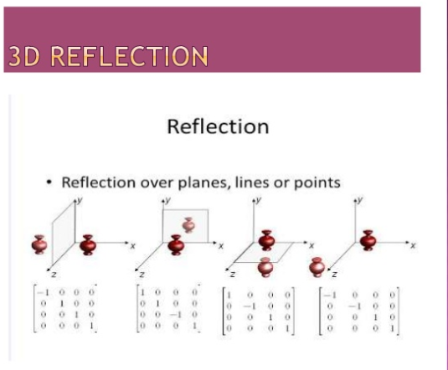

Slide 19
3d shearing
Modify object shapes
Useful for perspective projections to produce images look natural
When an object is viewed from different directions and at different distances, the appearance of the object will be different. Such view is called perspective view. Perspective projections mimic what the human eyes see.

Slide 20
3d shearing
We can denote shearing with ‘SH_{x,}’ ‘SH_{y,}’ and ‘SH_{z.}’ These ‘SH_{x,}’ ‘SH_{y,}’ ‘SH_{z}’ are called “Shearing factor.”

Slide 21
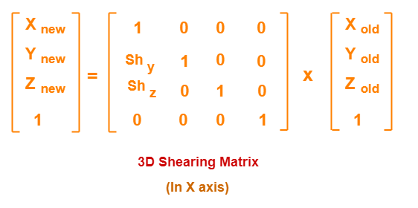
3d shearing
We can perform shearing on the object by following three ways-
Shearing along the x-axis: In this, we can store the x coordinate and only change the y and z coordinate.
We can represent shearing along x-axis by the following equation-
x₁ = x₀
y₁ = y₀ + SH_{y}. x₀
z₁ = z₀ + SH_{z}. X₀
3D Shearing Matrix: In Matrix form, the above shearing equations may be represented as-

Slide 22
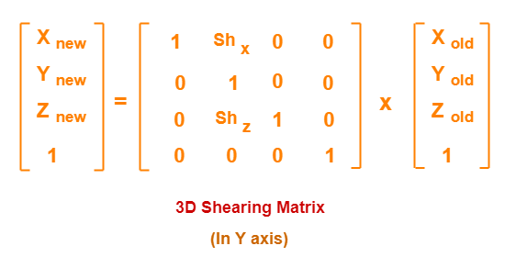
3d shearing
2. Shearing along the y-axis: In this, we can store the y coordinate and only change the x and z coordinate.
We can represent shearing along with y-axis by the following equation-
x₁ = x₀ + SH_{x}. y₀
y₁ = y₀
z₁ = z₀ + SH_{z}. Y₀
3D Shearing Matrix: In Matrix form, the above shearing equations may be represented as-

Slide 23
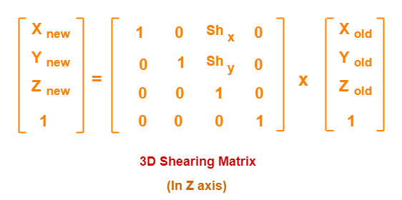
3d shearing
3. Shearing along with z-axis: In this, we can store the z coordinate and only change the x and y coordinate.
We can represent shearing along with z-axis by the following equation-
x₁ = x₀ + SH_{x}. z₀
y₁ = y₀ + SH_{y}. Z_{­0}
z₁ = z₀
3D Shearing Matrix: In Matrix form, the above shearing equations may be represented as-

Slide 24
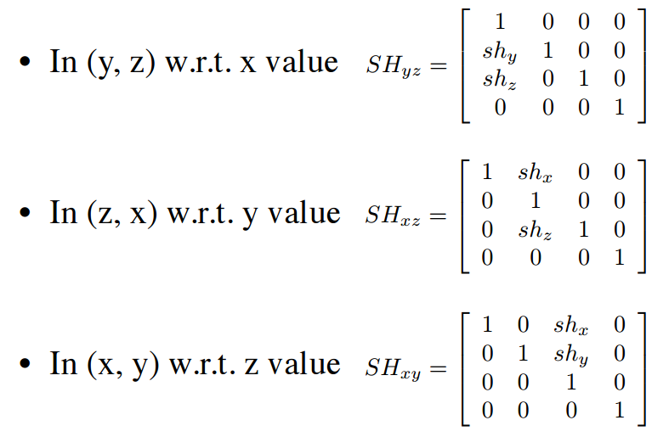
3d shearing

Slide 25
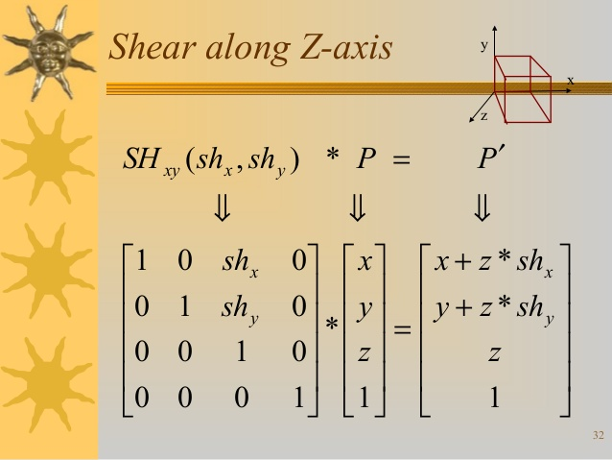
3d shearing

