Slide 1
ERD to Relational Schema

Slide 2
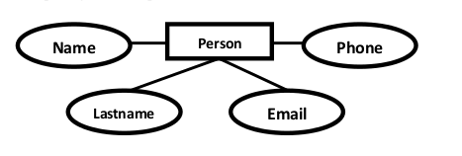
1. Entities and Simple Attributes:
An entity type within ER diagram is turned into a table.
Each attribute turns into a column (attribute) in the table.
Persons( personid , name, lastname, email, phone )

Slide 3

2. Multi-Valued and Composite Attributes
1. Create a table for the attribute. 2. Add the primary (id) column of the parent entity as a foreign key within the new table
Persons( personid , name)
Phones ( phoneid , personid, phone )

Slide 4
Derived Attribute
Derived attribute can be calculated at any point of time. Hence we need not create a column for this attribute. It reduces the duplicity in the database.

Slide 5
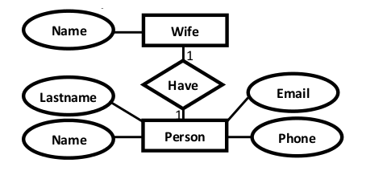
1:1 Relationships
Persons( personid , name, lastname, email, phone , wifeid )
Wife ( wifeid , name )
OR
Persons( personid , name, lastname, email, phone )
Wife ( wifeid , name , personid)

Slide 6
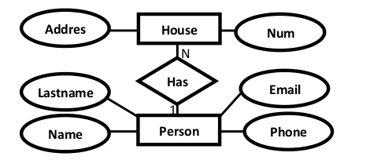
1:N Relationships
Persons( personid , name, lastname, email )
House ( houseid , num , address, personid)

Slide 7
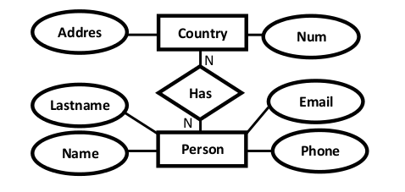
N:N Relationships
Persons( personid , name, lastname, email, phone )
Countries ( countryid , name, num)
HasRelat ( hasrelatid , personid , countryid)

Slide 8
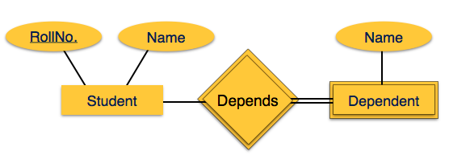
Mapping Weak Entity Sets
Create table for weak entity set.
Add all its attributes to table as field.
Add the primary key of identifying entity set.
Student(RollNo, Name)
Dependent(Name, RollNo)

Slide 9
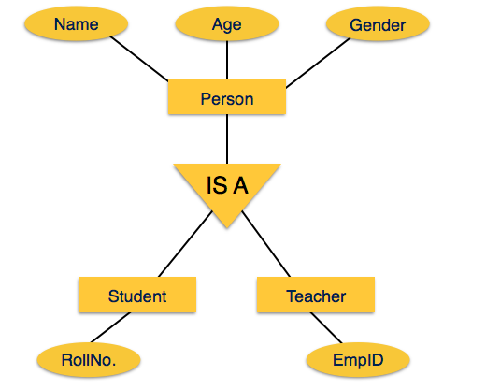
Mapping Hierarchical Entities
Create tables for all higher-level entities.
Create tables for lower-level entities.
Add primary keys of higher-level entities in the table of lower-level entities.
In lower-level tables, add all other attributes of lower-level entities.
Declare primary key of higher-level table and the primary key for lower-level table.
Person(PersonID, Name, Genger, Age)
Student(RollNo, PersonID)
Teacher(EmpID, PersonID)

Slide 10
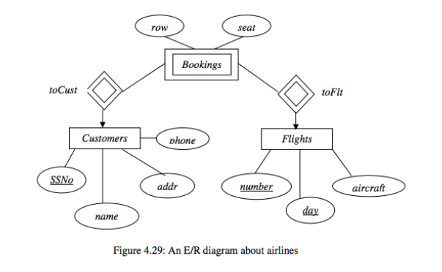
Exercise 1
Customers(SSN,name,addr,phone);
Flights(number,day,aircraft)
Bookings(SSN, number, day, row, seat)

Slide 11
Exercise 2
Stars(name,addr);
Studios(name,addr);
Movies(title,year,length,genre);
Contracts(StartName,studiosName,titile,year,salary).

Slide 12
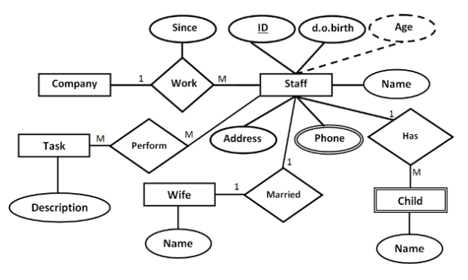
Exercise 3
Company( CompanyID)
Staff( StaffID , dob , address ,name, WifeID)
Child( ChildID , name , StaffID )
Wife ( WifeID , name )
Phone(PhoneID , phoneNumber , StaffID)
Task ( TaskID , description)
Work(WorkID , CompanyID , StaffID , since )
Perform(PerformID , StaffID , TaskID )

Slide 13
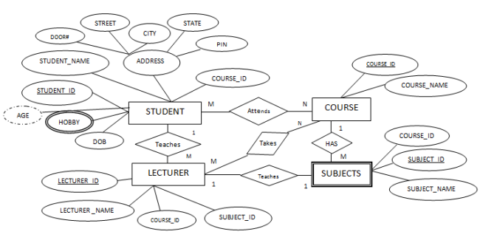
Exercise 4

