Slide 1
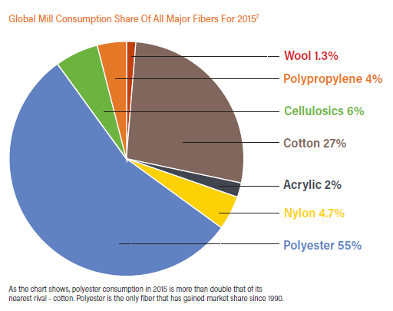
Raw Material of Textiles: Fibers

Slide 2
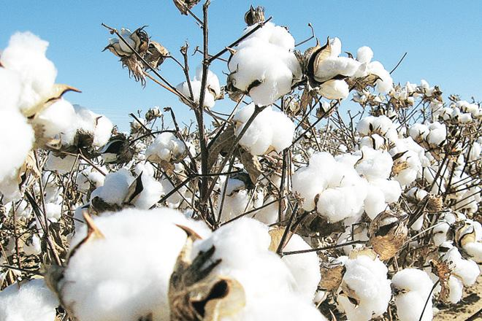
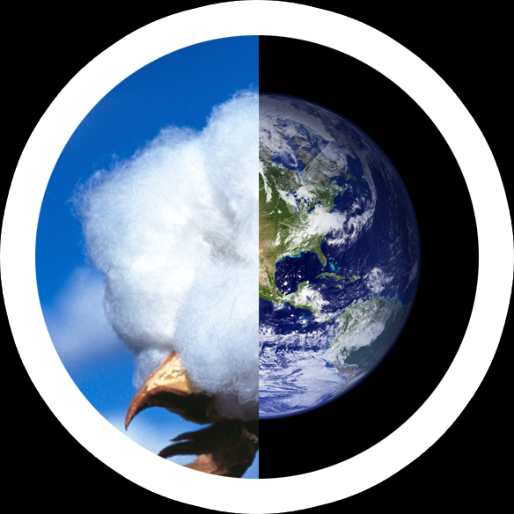
Cotton
Cotton is
  soft, fluffy staple fiber
  Grows in a ball
  Almost pure cellulose
Production
  Near about 25 million tons or 110 million bales annually
  Consume 2.5% of the world's arable(agricultural) land

Slide 3
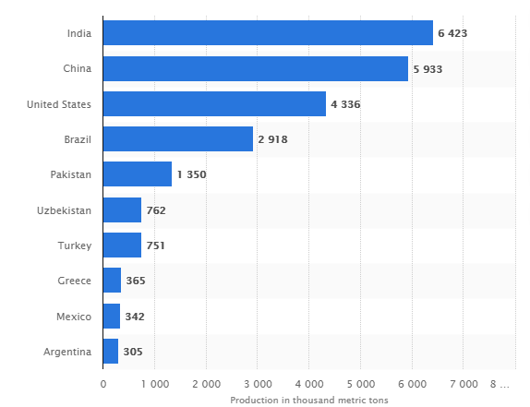
Leading cotton producing countries worldwide in 2019/2020(in 1,000 metric tons)

Slide 4
Below are the 15 countries that exported the highest dollar value worth of cotton during 2019.
1. China: US$14.1 billion (26.6% of total cotton exports)
2. United States: $7.9 billion (14.8%)
3. India: $6.3 billion (11.8%)
4. Vietnam: $2.9 billion (5.5%)
5. Brazil: $2.8 billion (5.2%)
6. Pakistan: $1.8 billion (3.3%)
7. Turkey: $1.7 billion (3.1%)
8. Italy: $1.3 billion (2.4%)
9. Hong Kong: $1.1 billion (2.1%)
10. Australia: $1.1 billion (2.1%)
11. Uzbekistan: $1.1 billion (2%)
12. Germany: $819.9 million (1.5%)
13. Spain: $683.6 million (1.3%)
14. Indonesia: $663.6 million (1.2%)
15. Greece: $636.7 million (1.2%)
Global sales from cotton exports by country in 2019 totaled US$53.3 billion. By value, the listed 15 countries shipped 84.2% of globally exported cotton in 2019.
Among the top exporters, the fastest-growing cotton exporters since 2015 were: Brazil (up 91.9%), Vietnam (up 72.3%), Greece (up 67.3%) and United States (up 34.6%).
Those countries that posted declines in their exported cotton sales were led by: Pakistan (down -56.6%), Hong Kong (down -52.7%), Indonesia (down -19.4%), Germany (down -16.5%) and India (down -16.2%)

Slide 5
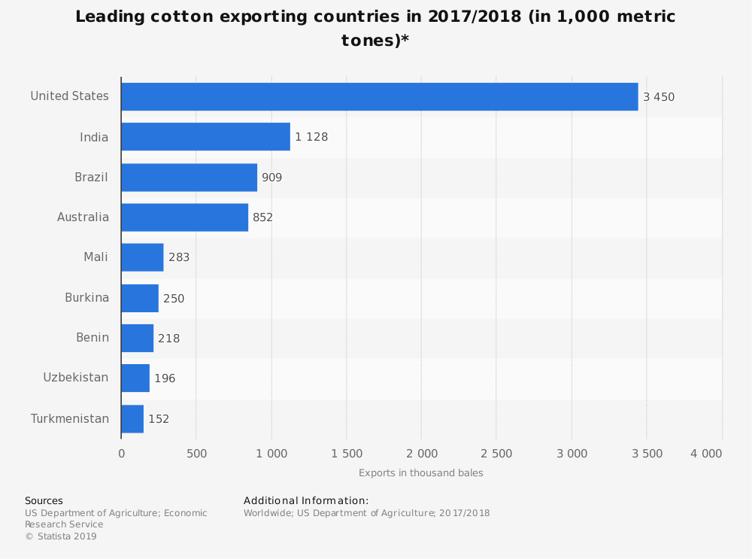
Leading Cotton Exporter 2017/2018

Slide 6
Cotton production in Bangladesh
The country produced 1.65 lakh bales of cotton 2017/2018 fiscal year, which is less than 3 percent of the annual demand for 10 million bales.
In 2016/2017, Cotton is grown in around 42 thousand hectares of land with a yearly production of nearly 1.5 lakh bales which is only 3 percent of the total quantity demanded by the textile and garments industries of Bangladesh.
In MY 2018/19 cotton imports are forecast up to 7.9 million bales on expectations of increased export market demand for value-added products. Gradual development of the upstream supply chain, including spinning, dyeing, finishing, weaving and printing creates more demand for cotton to meet required needs of the RMG industry.
In order to bump up local production, state-run Cotton Development Board is looking for new farming lands in hilly and swamp areas in various districts along with the existing farming areas in Jashore, Rangpur, Dinajpur, Rajshahi, Gazipur and Mymensingh.
The board hopes to produce 2.5 lakh bales of cotton by 2021, which will meet nearly 5-7 percent of the local consumption.

Slide 7
Cotton import or outsourcing of Bangladesh:
In 2017/2018, Bangladesh imported 8.28 million bales of cotton.
Bangladesh’s cotton imports will continue to be proportionate with the expansion in spinning, according to the latest report of the United States Department of Agriculture.
Nearly 80 percent of garments made in Bangladesh are sourced from cotton; the rest are made from viscose, polyester and other materials. Local spinners supply 90 percent of raw materials for knitwear and 40 percent for the woven garments sector.
About 97% of the total requirements are managed by importing raw cotton from-Uzbekistan, India, Pakistan, Turkmenistan and some cotton growing Sub-Saharan (African) countries.

Slide 8
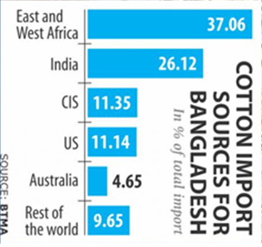
Cotton import or outsourcing of Bangladesh on 2017/2018:

Slide 9
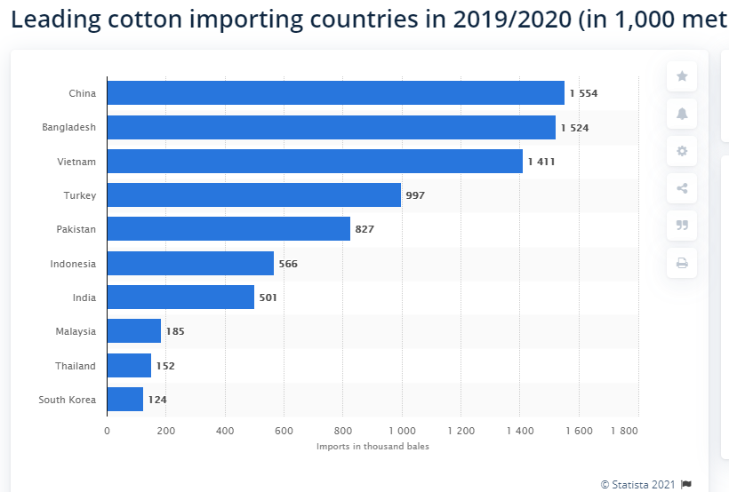
Leading cotton importing countries in 2019/2020 (in 1,000 metric tones)*

Slide 10
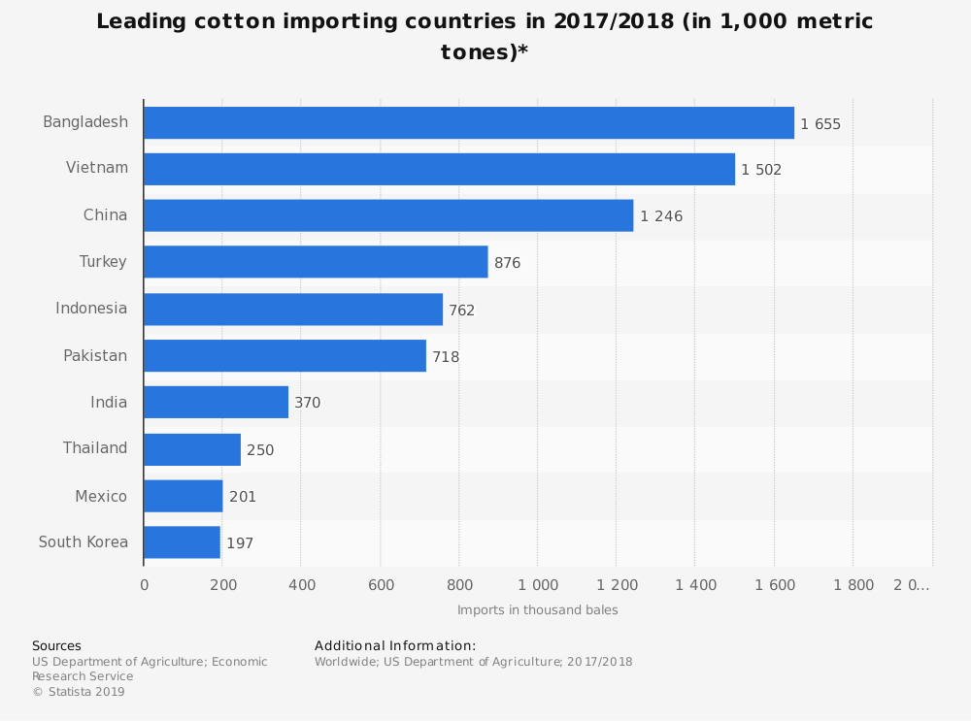
Leading cotton importing countries in 2017/2018 (in 1,000 metric tones)*

Slide 11
Cotton import or outsourcing of Bangladesh:
African nations have surpassed India to become the largest source of cotton for Bangladesh as local spinners and millers become free from the dependency of a single source for their vital raw material.
In FY 2017/2018, Bangladesh, the largest importer of cotton in the world, met 37.06 percent of its requirement for the white fibre from East and West African countries.
The total cotton imports from India was 26.12 percent, down from more than 60 percent two years ago, according to the Bangladesh Textile Mills Association (BTMA).
In FY 2017/2018, 11.35 percent of the cotton came from the CIS (Commonwealth of Independent States) countries, 11.14 percent from the US, 4.65 percent from Australia and 9.65 percent from the rest of the world.
Bangladesh imports cotton from 42 countries around the world.

Slide 12
Causes of Shifting from India to Africa for Cotton import in 2017/2018
Low quality: The low quality of the Indian cotton is the main reason behind the falling imports from the neighboring country according to BTMA.
Late Shipment: A section of Indian cotton traders cannot maintain timely shipment
Short Quantity: Indian cotton traders does not deliver the right quantity of cotton as per agreement, according to the Bangladesh Cotton Association. For example, it is written in the letter of credit that there may be 3 to 4 percent less cotton than the amount agreed upon when the imported fibre is weighed in Bangladesh. But in many cases it is 10 to 15 percent less which is a big loss for Bangladesh. This is another reason for moving away from India.
Moisture: The concentration of moisture in the Indian cotton is higher than in other countries’, which makes it difficult to store in the warehouses for a long time.

Slide 13
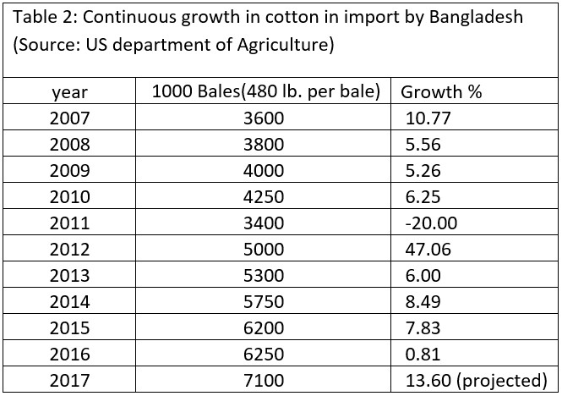
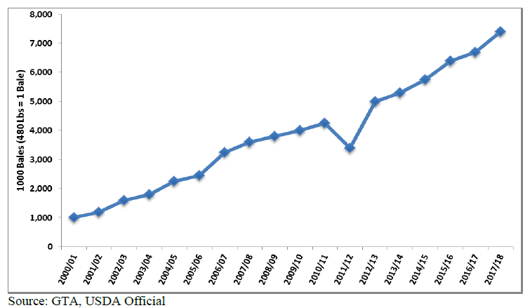
Increasing trend of Cotton import of Bangladesh

Slide 14
Price of Cotton
The price of cotton is counted in U.S. Dollars per pound. The current price of cotton as of March 08, 2019 was $0.7349 per pound and as of March 24, 2021 is $ 84.62 per pound
Historically, Cotton reached an all time high in March of 2011 and a record low in December of 1930.
Cotton is sold in bale,
Cotton bale weighs
396.6 pounds (180 kilograms) in Brazil,
730 pounds (331.1 kilograms) in Egypt and the UK,
392 pounds (177.8 kilograms) in Bangladesh, India, and Pakistan, and
480 pounds (217.7 kilograms) in the US.

Slide 15
Carded Yarn | LC price/Kg
10/1 Carded 100% cotton yarn | 3.00 $
16/1 Carded 100% cotton yarn | 3.10 $
18/1 Carded 100% cotton yarn | 3.15 $
20/1 Carded 100% cotton yarn | 3.15 $
24/1 Carded 100% cotton yarn | 3.25 $
28/1 Carded 100% cotton yarn | 3.30 $
30/1 Carded 100% cotton yarn | 3.30 $
34/1 Carded 100% cotton yarn | 3.50 $
36/1 Carded 100% cotton yarn | 3.60 $
40% Carded 100% cotton yarn | 3.85 $
Yarn price list in local market of Bangladesh (Updated on 28.09.2018):
Carded Yarn

Slide 16
Combed yarn | LC Price
10/1 Combed 100% Cotton Yarn | 3.35 $
16/1 Combed 100% Cotton Yarn | 3.45 $
18/1 Combed 100% Cotton Yarn | 3.50 $
20/1 Combed 100% Cotton Yarn | 3.50 $
22/1 Combed 100% Cotton Yarn | 3.55 $
24/1 Combed 100% Cotton Yarn | 3.60 $
26/1 Combed 100% Cotton Yarn | 3.60 $
28/1 Combed 100% Cotton Yarn | 3.65 $
30/1 Combed 100% Cotton Yarn | 3.65 $
32/1 Combed 100% Cotton Yarn | 3.75 $
34/1 Combed 100% Cotton Yarn | 3.85 $
36/1 Combed 100% Cotton Yarn | 3.95 $
40/1 Combed 100% Cotton Yarn | 4.20 $
Combed Yarn

Slide 17
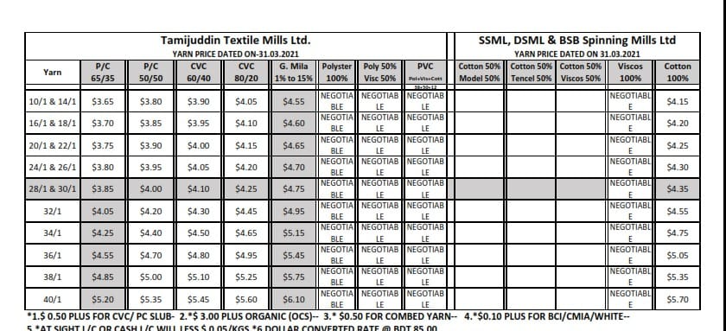
Yarn Price as of 31.03.2021

Slide 18
Polyester
Top 10 polyester Exporters country
RANK | COUNTRY | EXPORTS(BILLION $)
1 | China | 2,210
2 | United States | 1,575
3 | Germany | 1,493
4 | United Kingdom | 813.2
5 | Japan | 697
6 | France | 578.6
7 | Netherlands | 576.9
8 | Korea, South | 557.3
9 | Russia | 515
10 | Italy | 474

Slide 19
Market Share

Slide 20
Top 10 polyester importers country
RANK | COUNTRY | IMPORTS(BILLION $)
1 | United States | 2,273
2 | China | 1,950
3 | Germany | 1,233
4 | United Kingdom | 782.5
5 | Japan | 766.6
6 | France | 659.8
7 | Hong Kong | 520.6
8 | South Korea | 516.6
9 | Netherlands | 511
10 | Canada | 471

Slide 21
Market Share

Slide 22
Uses of Polyester fibre:
Use of Polyester in Garments:
Polyester is used in the manufacturing of all kinds of clothes and home furnishings like bedspreads, sheets, pillows, furniture, carpets and even curtains.
Industrial Uses of Polyester:
  Polyester fibre and filament:
    Polyester Staple Fiber(PSF): As textile fiber, Total Production was 17.9 million tons in 2018
    Polyester Filament Yarn (PFY): As textile Yarn, Total Production was 37.5 million tons in 2018
  PET: The most common use of polyester today is to make the plastic bottles that store our much beloved beverages. These shatterproof and cheap bottles are an absolute boon to the beverages industry.
  Mylar: An unusual and little known use of polyester is in the manufacturing of balloons which are really pretty decorated ones that are gifted on special occasions. These are made of Mylar – a kind of polyester film manufactured by DuPont. The balloons are made of a composite of Mylar and aluminum foil.
  Miscellaneous:Polyester is also used to manufacture high strength ropes, thread, hoses, sails, power belting and much more in industries.

Slide 23
Jute
Top jute cultivating and growing countries of the world:
Jute is not cultivated in all over the world.
Special soil characteristics are required for the jute cultivation. Jute is specially cultivated sub-continent and surrounding countries
Bangladesh and west Bengal of India are the highest jute cultivator. About 85% jute is cultivated in this area.
List of Top Jute growing countries -
    India
    Bangladesh
    China
    Myanmar
    Uzbekistan
    Nepal
    Thailand
    Vietnam
    Egypt
    Brazil

Slide 24
Top jute importing &exporting countries of the world:
China is the biggest trade market in the world.
List of top jute importing countries-
China
Pakistan
India
Nepal
Cote dlvoire(a country located on the south coast of West Africa)
In the world trade, jute sector takes a great place. It is great news for the farmer
who is growing jute because peoples are feeling the demand of natural fiber. Jute
fibers are cheaper than cotton fiber.
List of top raw jute exporting countries -
Bangladesh
India
Kenya
Pakistan
Tanzania

Slide 25
Top jute producing countries& their share:
 | Country | Jute Production | %of World Total
01 | India | 19,910,000 m/t | 55.1%
02 | Bangladesh | 1,452,044 m/t | 41.9%
03 | China | 45,500 m/t | 1.3%
04 | Uzbekistan | 20,000 m/t | 0.57%
05 | Nepal | 14,424 m/t | 0.41%

Slide 26
Jute Pricing
Types of Jute | Price(BDT/kg)
BTC | 65
BTD | 55
BTE | 45
WTC | 62
WTD | 50
WTE | 40

Slide 27
Types of Jute
Bangla Tossa Clean (BTC): Uniform color, golden/red, Tossa of finest texture, Very strong and very good luster. Completely free from any defects. Clean cut and well hackled.
Bangla Tossa (BTD) = X-1,2,3: Uniform Colour, Light golden to reddish,Tossa of fine texture, strong and good luster. Free from any blemish completely. Clean cut and well hackled.
Bangla Tossa-E (BTE): Any colour, any strength but free from perished fibre. Free from unfretted jute and stick but bark and hard center permissible. Rough cut and hackled.
  Bangla Tossa Jute (Corchorus olitorius)
  Bangla White Jute (Corchorus capsularis)

Slide 28
Wool
Top Exporting Countries
Country | Export value | Percent of total export
Australia | $1.94 B | 67%
New Zealand | $226 M | 7.8%
South Africa | $248 M | 8.6%
Uruguay | 64.4M | 2.2%
United Kindom | 54.4M | 1.9%
Argentina | 49.7M | 1.7%
Germany | 46.8M | 1.6%
Spain | 34.4M | 1.2%
Brazil | 30.6M | 1.1%
Peru | 21.8M | 0.75 %

Slide 29
Top Wool fibre importing countries
Country | Imprt value | Percent of total import
China | 2.13B | 72%
India | 242M | 8.2%
Czech Republic | 180M | 6.15%
Italy | 149M | 5%
Uruguay | 50.6M | 1.7%
Egypt | 40.6M | 1.4%
United kindom | 21.5M | 0.73%
Turkey | 19.2M | 0.65%
Germany | 12M | 0.41%
United states | 8.4M | 0.289%

Slide 30
Price comparison (US cents/lb)
Cotton | Polyester | Wool | Viscose | Nylon
75-85 | 60-70 | 600 | 100-110 | 160-170

Slide 31
Bangladesh apparel sector has 95% local investors: BGMEA
Over 95 per cent of the total investors in the Bangladesh apparel industry are local. Moreover, Bangladesh also has a number of foreign investors in textile and apparel sectors. The country encourages foreign investments in the areas of high value added items, non-traditional apparel items and in the primary textile industry, especially woven textiles
Bangladesh is also working on decreasing its dependency on imports as there has been a significant capacity building in the area of yarn and fabrics manufacturing, especially for knitwear items.
Around 95 per cent of the knitted fabrics are produced in Bangladesh. Denim production capacity has also got a significant boost in the last decade. Almost 50 per cent of the demand for denim fabric by our export oriented garment industry is being fulfilled by our local denim mills. Besides, Bangladesh produces almost 100 per cent of its accessories needed locally.
The country is dependent on external sources mostly for fibre, because it does not grow cotton or petrochemical products. It is lagging behind in woven fabric production, which has potentials for investment- BGMEA

Slide 32
China's Relocation Helps Bangladesh become top garment exporter
China can play a major role in making Bangladesh the world's top exporter of garments, according to analysts. Chinese industrialists are now planning to relocate their garments and textile industries, especially those manufacturing low-end apparel. These can be shifted to Bangladesh, where the government is planning to award a special economic zone to China.
If Bangladesh plays its cards correctly, it can emerge as the number 1 readymade garment exporter in the world in the next 10 years
China currently accounts for nearly 40 per cent share of global apparel consumption, which stood at $445 billion in 2015. In comparison, Bangladesh is far behind with around 6 per cent share.

Slide 33
Bangladesh garment industry at a glance
Over 95 per cent of the total investors in the Bangladesh apparel industry are local.
Bangladesh has a number of foreign investors in textile and apparel sectors who investments in the areas of high value added items, non-traditional apparel items and in the primary textile industry, especially woven textiles
Bangladesh is working on decreasing its dependency on imports as this country is trying to build a significant capacity in the area of yarn and fabrics manufacturing, especially for knitwear items.
Around 80 per cent of the knitted fabrics are produced in Bangladesh.
Denim production capacity has also got a significant boost in the last decade. Almost 50 per cent of the demand for denim fabric by our export oriented garment industry is being fulfilled by our local denim mills.
Bangladesh produces almost 100 per cent of its accessories needed locally.
Bangladesh’s export earnings from the apparel sector registered $30.61 billion in FY18
  Global market share 6.5% in FY2017/18
  40 million workers
  4560 garment factories
  $50bn export target by 2021
The country is dependent on external sources mostly for fibre, because it does not grow cotton or petrochemical products. It is lagging behind in woven fabric production.

