Slide 1
Processing of Textiles
Sub sectors of Textiles are majorly divided into
    Spinning
    Fabric (Weaving/Knitting)
    Dyeing and Finishing
    Garments/ Apparel-
                Woven
                Knit
                Home textile
                Sweater

Slide 2
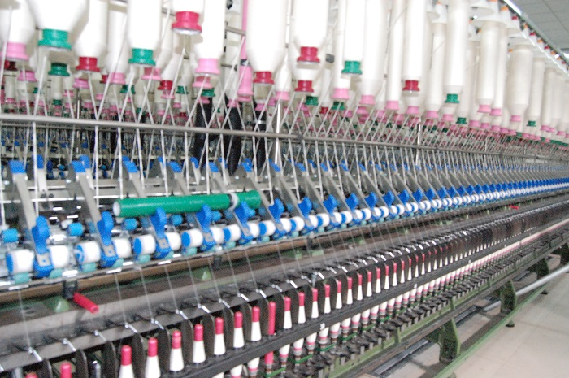
Spinning sub sector

Slide 3
Spinning Industry in Bangladesh
The primary textile sector (PTS) or backward linkage industries are producing yarn and fabric needed for readymade garment sector (RMG).
PTS is the backbone of clothing industries because it provides yarn, the primary raw material or the backward linkage for both the woven and knit sector to produce fabric.
PTS is usually the factories under the leadership of Bangladesh Textile Mills Association (BTMA).

Slide 4
Spinning Industry in Bangladesh
The private sector spinning mills can now meet around
      100% demand of yarn at the domestic level as well as
      95% of the demand for yarn for export oriented knit fabrics mills.
      Almost 85% of cotton yarns, and 50% demand for synthetic and blended yarn of export-oriented fabric producing mills are being met by the private sector spinning mills.
      Conversion Processing Cost: from Cotton to Yarn:
      BDT 15+ per pounds

Slide 5
Chronological development of Spinning
Year | No of Mills | Spindle Capacity | Remarks
2006 | 260 | 5500,000 | After Phase out of Quota
2009 | 350 | 7600,000 | After Phase out of Quota
2012 | 392 | 9800,000 | After Phase out of Quota
2015 | 413 | 11050,000 | After Phase out of Quota
2016 | 424 | 11650,000 | After Phase out of Quota
2017 | 430 | 12000,000 | After Phase out of Quota

Slide 6
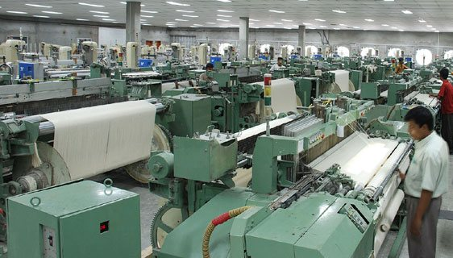
Fabric (Weaving and Knitting) sub Sector
Numbers of Fabric Manufacturing Unit in Bangladesh: 802 (BTMA)

Slide 7
Processing Cost: Yarn to Fabric (Knit) per KG
Types of Fabric | Knitting Charge
Single jersey | BDT 10-12
Rib/Interlock | BDT 20-25
Fleece | BDT 20-25
Terry | BDT 35
Engineering Stripe | BDT 150-200
Lycra attached S/J | BDT 16-20

Slide 8
Cost break down of Knitting(Cir. knit)
M/C depreciation cost = 2.25 taka/kg
Needle cost = 1.45 taka/kg
Sinker cost = 0.20 taka/kg
Lubricant cost = 0.82 taka/kg
Electricity cost = 0.45 taka/kg
Spare parts cost = 0.05 taka/kg
Knitting floor charge = 0.33 taka/kg
Salary = 1.85 taka/kg
Others = 0.10 taka/kg
……………………………………..
Knitting cost = 7.5 taka/kg

Slide 9
Finishing Cost of Knit Fabric
Operation | Cost/Kg (BDT)
Slitting only | 5
Stenting only | 25
Compacting only (Open) | 15
Stenting + Compacting | 35
Stenting + Compacting + Wash | 50
Tube Compacting | 10

Slide 10
Processing Cost Calculation: Fabric (Woven)
Construction of an woven fabric is 120x80/30x20 and width is 60’’. Consider price of warp and weft yarn is BDT 90 and BDT 80 respectively. Consider standard crimp% (10-15%), weaving cost (15-30 BDT/Yard), dyeing cost (25-45 BDT/yard), transport cost (BDT 5/yard), commercial cost (BDT 2/yard) and profit (BDT 15/yard). Calculate the quoted price of one yard fabric considering conversion rate BDT 84 per US Dollar.
  Solution:
    Total number of ends 120x60
    Warp Consumption: …………………………………………….x Crimp% = ……………………….x 10% = 0.2857 x 1.1= 0.314 lbs/Yard
    Warp Countx840 30x840
    Total number of picks 80x36
    Weft Consumption: …………………………………………….x Crimp% = ……………………x10% = 0.1714x1.1= 0.189 lbs/Yard
    Weft Countx840 20x840
    Total Consumption : (0.314+ 0.189) lbs/yard = 0.503 lbs/Yard

Slide 11
Processing Cost: Fabric (Woven) – Conti…
  Price of Warp yarn = 0.314x90 = BDT 28.26
  Price of Weft yarn = 0.189x80 = BDT 15.12
  Total Yarn Cost: BDT ( 28.26+15.12 ) = BDT 43.38
Weaving Cost per Yard = BDT 20.00
Dyeing Cost per Yard = BDT 30.00
Transport Cost per Yard = BDT 5.00
Commercial Cost per Yard = BDT 2.00
Profit per Yard = BDT 15.00
………………………………………………………………………………………………..
Total Cost per Yard = BDT115.38
Quoted price in US$ = = 115.35/84 = US$ 1.38 per yard

Slide 12
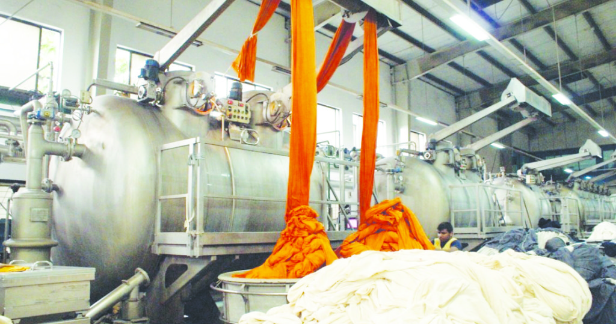
Dyeing printing and finishing sub sector
Numbers of Dyeing, printing and finishing Mills: 244

Slide 13
Processing Cost: Dyeing and Finishing-Knit
Type of Color | Dyeing Charge | Finishing Charge
White | BDT 60 | BDT 10-15
Light Color | BDT 90 | BDT 10-15
Dark Color | BDT 120-130 | BDT 10-15
Black | BDT 80 | BDT 10-15

Slide 14
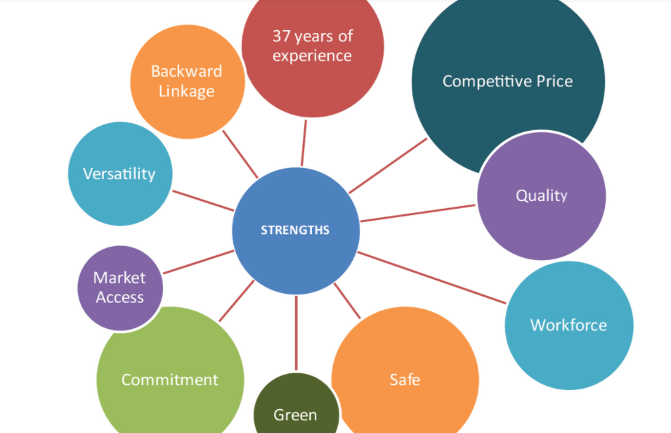
Bangladesh is a reliable source of RMG, because of

Slide 15
Ready Made Garment (RMG) sub sector
Strength of RMG industry of Bangladesh:
  Around 40 years of experience and reputation in garment manufacturing
  International standard quality
  Vibrant population, 70% below 40 years age, quick learning & dedicated
  Irresistible & resilient entrepreneurial spirit
  Duty free market access in most of the developed countries & PTA(Preferential Tariff Agreement ) in India, China, S. Korea, Malaysia.
  Rapid adoption of environment friendly, energy efficient and green concepts
  Versatility of factories to produce different type of products
  Increasing trend of direct sourcing through local liaison offices at Dhaka

Slide 16
Export Performance of RMG (Million US$)
Year | Export of RMG | Total Export of BD | % of RMG
1983-84 | 31.57 | 811.00 | 3.89
1989-90 | 624.16 | 1923.70 | 32.45
1994-95 | 2228.35 | 3472.56 | 64.17
1999-00 | 4349.41 | 5752.20 | 75.61
2002-03 | 4912.09 | 6548.44 | 75.01
2006-07 | 9211.23 | 12177.86 | 75.64
2010-11 | 17914.46 | 22924.38 | 78.15
2011-12 | 19089.73 | 24301.90 | 78.55
2012-13 | 21515.73 | 27027.36 | 79.61
2013-14 | 24491.88 | 30186.62 | 81.13
2014-15 | 25491.40 | 31208.94 | 81.68
2015-16 | 28094.16 | 34257.18 | 82.01
2016-17 | 28149.84 | 34655.90 | 81.23
2017-18 | 30614.76 | 36668.17 | 83.49
2018-19 | 34133.27 | 40535.04 | 84.21
2019-20 | 27949.19 | 33674.09 | 83.00

Slide 17
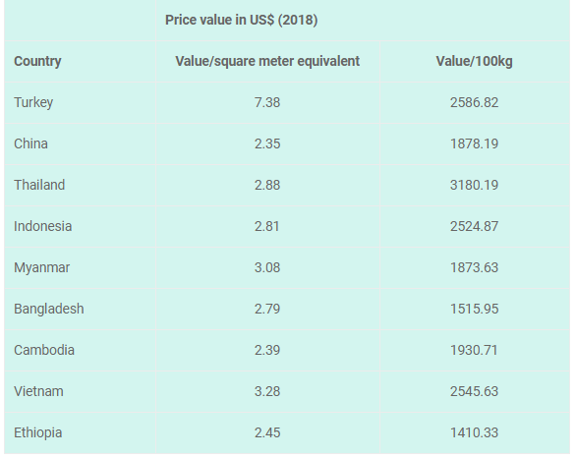
Garments’ price of different countries in the USA market

Slide 18
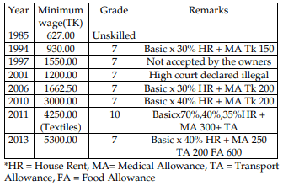
Minimum wages in different periods in RMG

Slide 19
Minimum wage of RMG workers – from Dec. 2018
Grade | Position | Basic (BDT) | Gross (BDT) | Designation
7 | Apprentice | 4100 | 8000 | Apprentice
6 | Helper | 4380 | 8420 | Helper of sewing, cutting, finishing, etc.
5 | Junior Operator | 4683 | 8875 | Junior operator of machine, button attaching, etc.
4 | Operator | 4998 | 9347 | Sewing m/c operator, QI, Cutter, Packer, Line Chief, etc.
3 | Senior Operator | 5330 | 9845 | Sample Machinist, Senior Machine Operator, etc.
2 | High Skilled Worker | 9044 | 15416 | Mechanic, Electrician, Cutting Master, etc.
1 | Highly Skilled Worker | 10938 | 18257 | Pattern Mater, Chief Quality Controller, etc.

Slide 20
Calculation of Over Time (OT)
Basic Salary x 2
Hourly OT= ---------------------------------
208 (26 days x 8 hours)
Q. Calculate the payment for the Over Time (OT) of a sewing operator who worked 45 hours OT and the basic salary of the operator is BDT 5000.

Slide 21
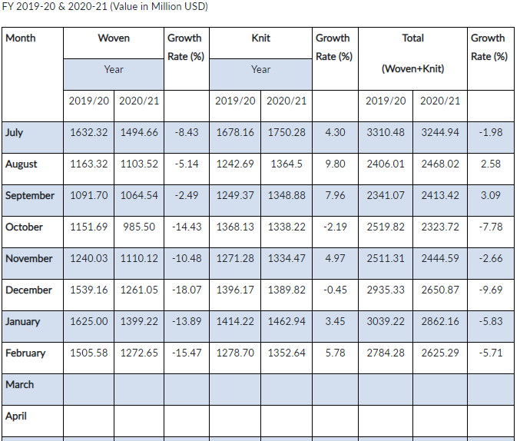
Impact of Covid 19 in RMG Export in 2020-2021

